Slide 1
Schedule A Meeting
Salem State University
Information Technology Department
Spring 2021
Presented By: Rajib Hossen
Advisor: Dr. Lakshmidevi Sreeramaraddy

Slide 2
Schedule A Meeting Outline
Student Objectives
Problem Specification
Functionality
Tools List
Benchmark Specifications
Entry Relational Model
Solution Design
Schedule for Project Implementation
Grading Scheme
Deliverables
Suggestions and Questions

Slide 3
Student Objectives
The goal of the project is to create a website that will help me to better understand web development platform and a real-world problem-solving experience.
The project will help me to gather some new skill and experience including.
1. Better understanding of HTML, CSS, JavaScript, PHP.
2. Using frameworks like WordPress and Bootstraps.
3. Better understanding of relational database and use of programing language.
4. Learning connection set up among PHP, SQL, and JavaScript.
5. Implementing various usability features
6. URL request and other aspects of this projects

Slide 4
Functionality
Here are the functionality that I want to have for my website.
The website would be universally accessible
Use GitHub for code sharing and development
Convert to one language other than English
Ability for users to change fonts
Different colors and contrast for color blind people
It also compatible with different screen sizes such as desktop, mobile, and tablet.

Slide 5

Tools
Some of the list of tools that I will use to make my project fully developed is listed below:
HTML: To create and structure the webpage.
CSS: To style the webpage and improve its quality including different fonts, colors, and other styles.
JavaScript: To work on creating client-side for the website to add additional features
SQL: To communicate with database like creating, adding, deleting, and finding specific data.
Notepad++: To edit the code if I find any issue with it.
DNS: I may use DNS for webhosting or AWS server
For the Front-end: Bootstraps, WordPress
For the Back-end: Python, Django, SQL.

Slide 6
Benchmark Specifications
Researching API request, URLs for domain name, and connection between interfaces.
Implementing programing languages to create fully functional website.
Testing, Debagging, and Documenting major events for the website
Final test to make it no mechanical or spelling errors.
Make the website ready to present.

Slide 7
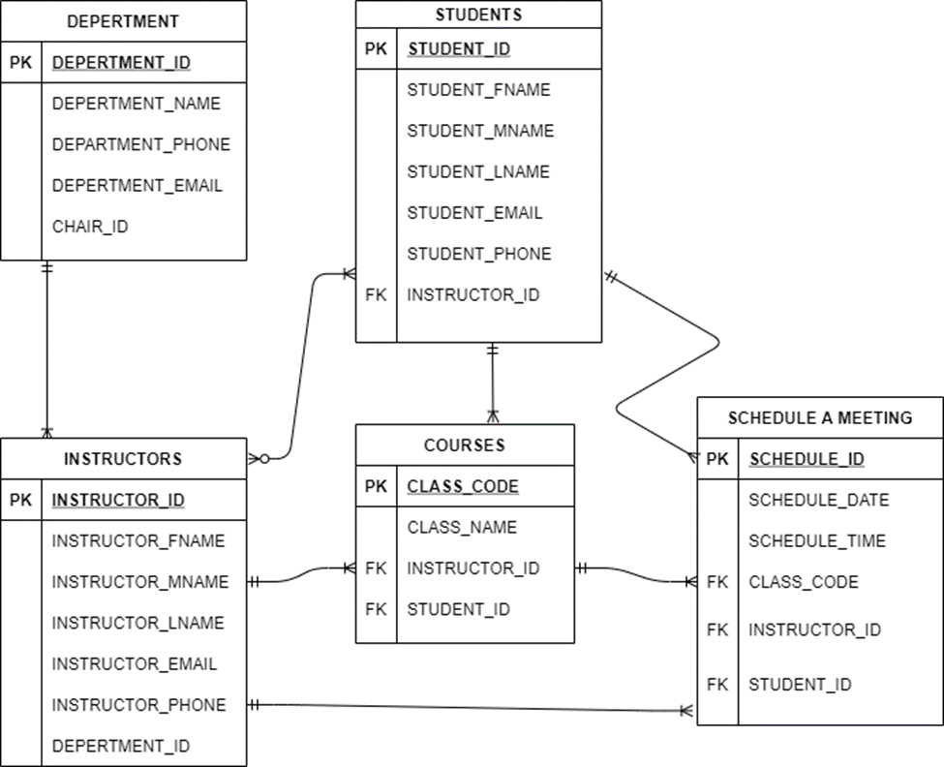
Entry Relations Diagram

Slide 8
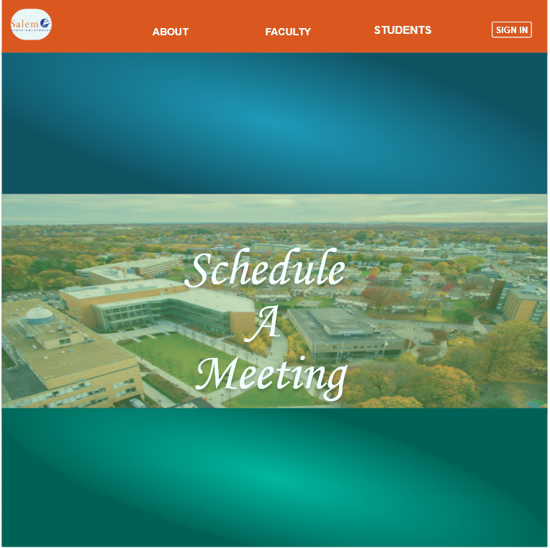
Solution Design Home Page

Slide 9
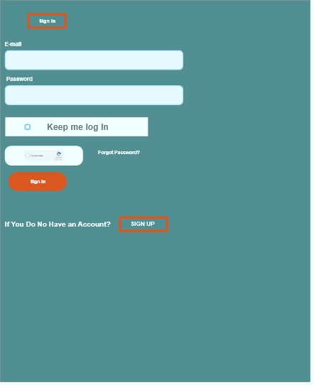
Sing In

Slide 10
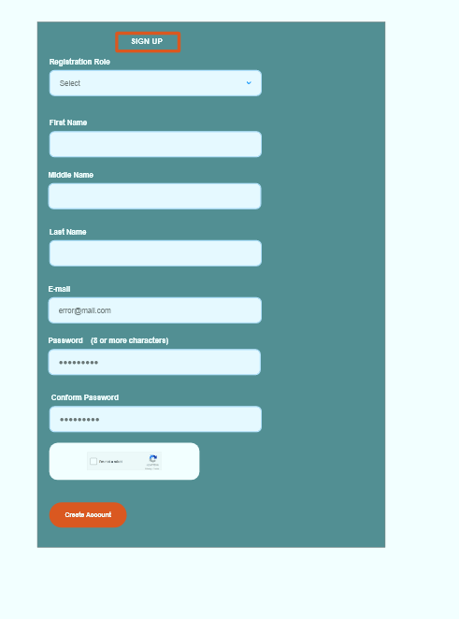
Sign Up

Slide 11
Sing In

Slide 12
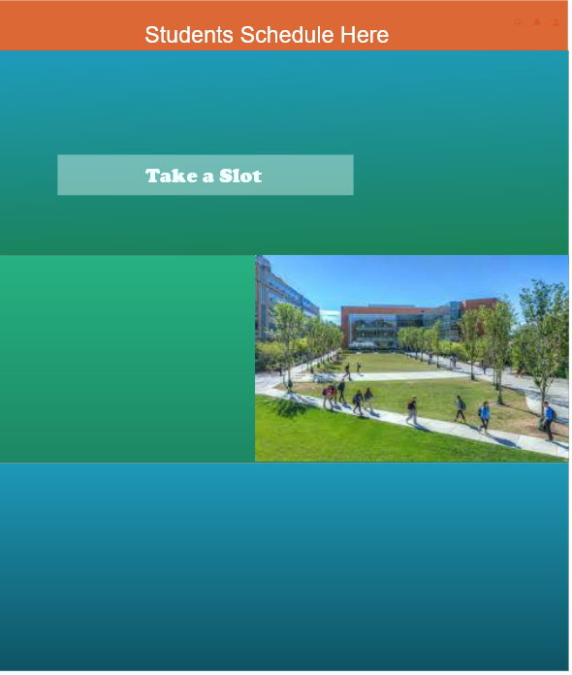
Students Interface

Slide 13
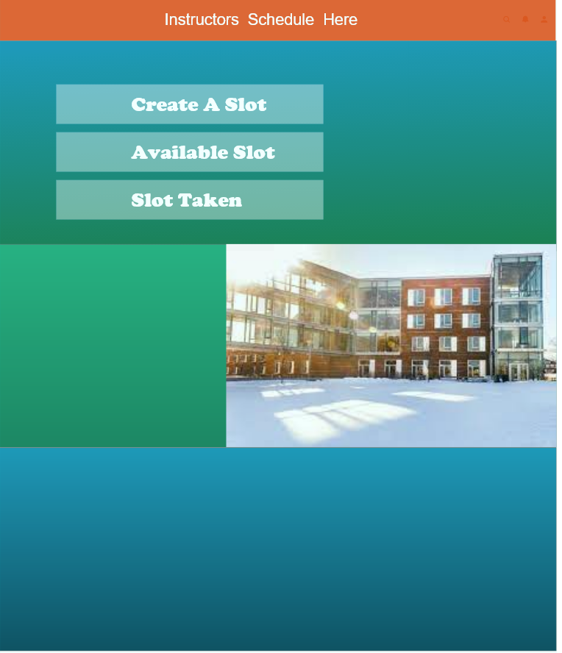
Instructor Interface

Slide 14
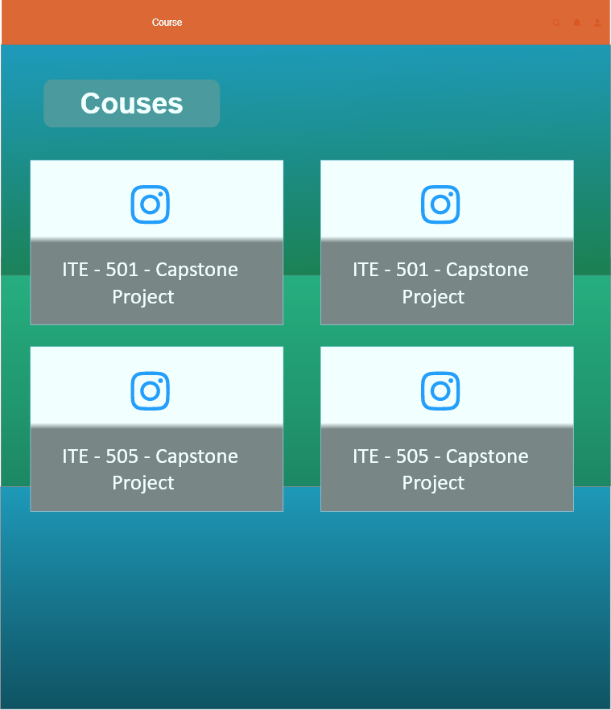
Courses

Slide 15
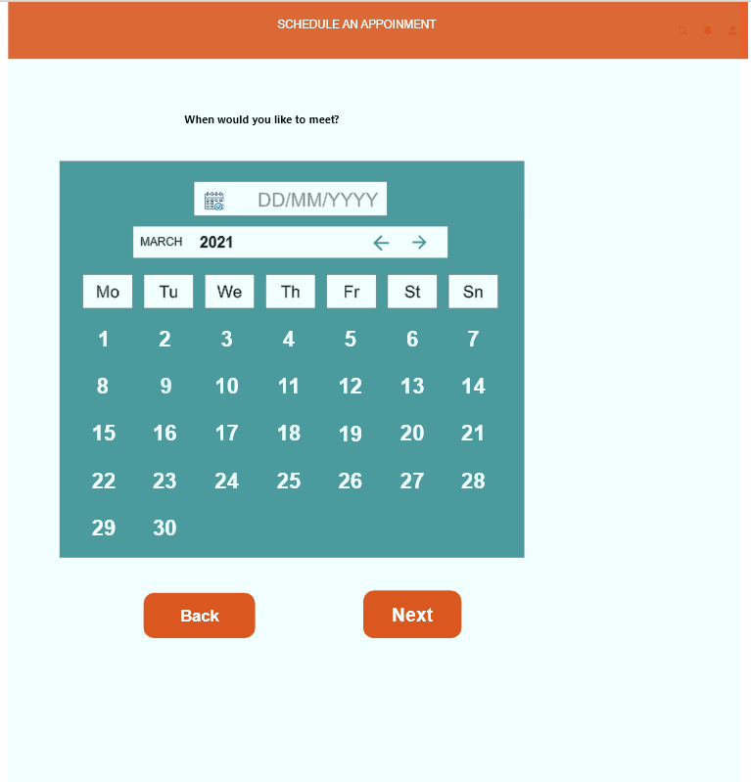
Create Slot Date

Slide 16
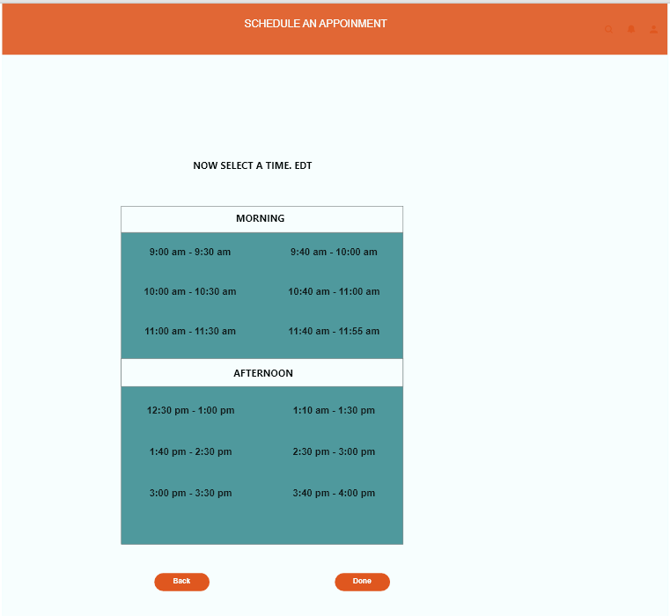
Create slots Time

Slide 17
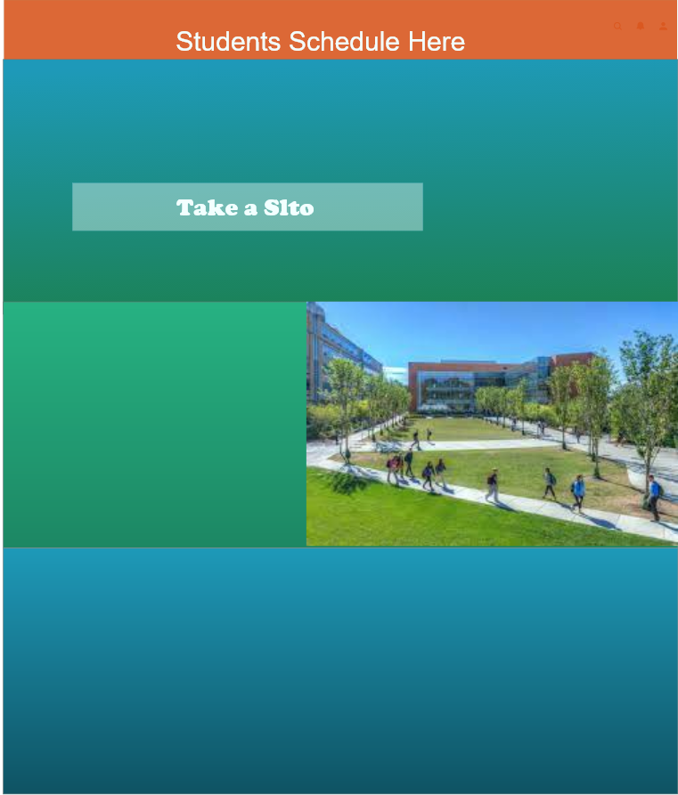
Students Interface

Slide 18
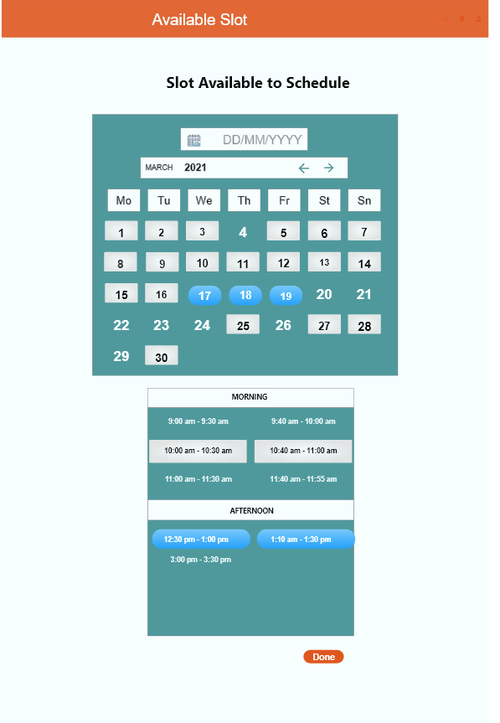
Once students take the slots

Slide 19
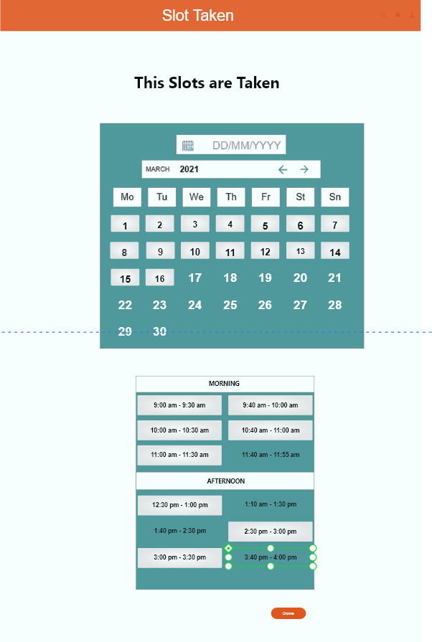
Slots are Taken

Slide 20
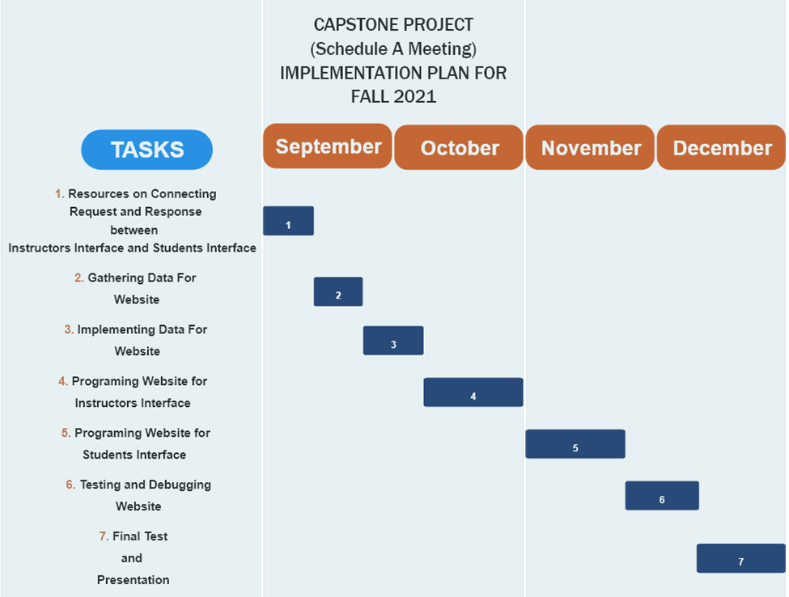
Schedule for Project Implementation

Slide 21
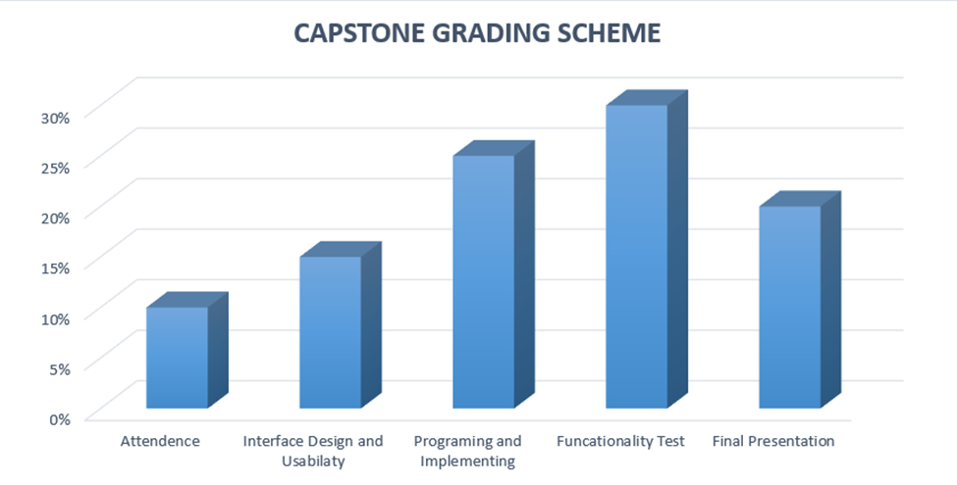
Grading Scheme

Slide 22
Deliverables
Project Items (ITE 505):
Project Source Code
Progress Records
Access to live demonstration server
Project functionality Test and Screenshots
Written Reflection Documentation
Final Presentation

Slide 23
Thank You
Any Questions ? Any Suggestions?

